Slide 1
CVS ViewVC
Web-base version control repository browsing.

Slide 2
Overview
What is CVS?
DirecTV ViewVC System.
CVS ViewVC for Tester.

Slide 3

1. What is CVS?
About CVS ViewVC.
ViewVC Features.
What are “HEAD” and “MAIN”?

Slide 4


1.1. About CVS ViewVC.
What is CVS?
  "CVS" is an acronym for the "Concurrent Versions System".
  CVS is a "Source Control" or "Revision Control" tool designed to keep track of collections of files in a shared directory called "The Repository".
  CVS is intended to handle source control for files in three major situations:
    Multiple developers working on the same files.
    Tracking a stream of releases from a source vendor.
    Branching development.
What is ViewVC?
  ViewVC is a browser interface for CVS and Subversion version control repositories.
  It generates templatized HTML to present navigable directory, revision, and change log listings.
  It can display specific versions of files as well as diffs between those versions.
Confidential

Slide 5
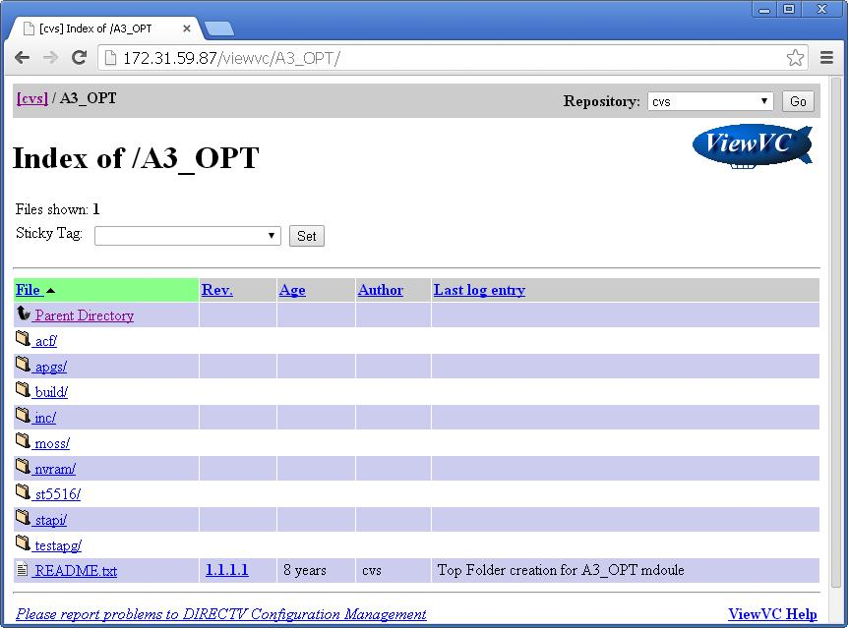
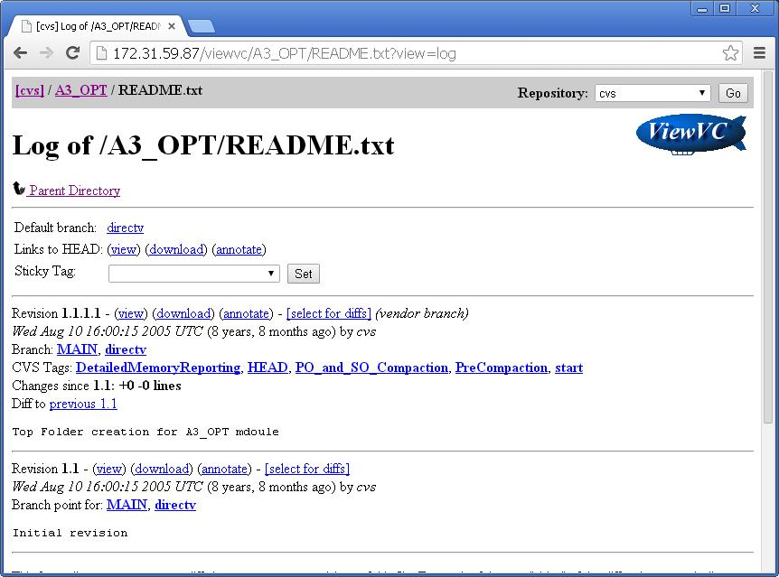
1.2. ViewVC Features
Log View : Shows a revision by revision list of all the changes that have made to a file or directory in the repository, with metadata and links to views of each revision.
Directory View : Shows a list of files and subdirectories in a directory of the repository, along with metadata like author names and log entries.
Confidential

Slide 6
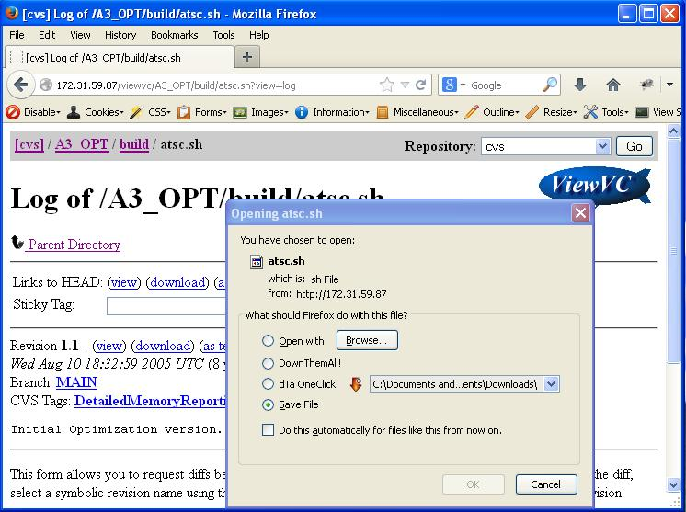
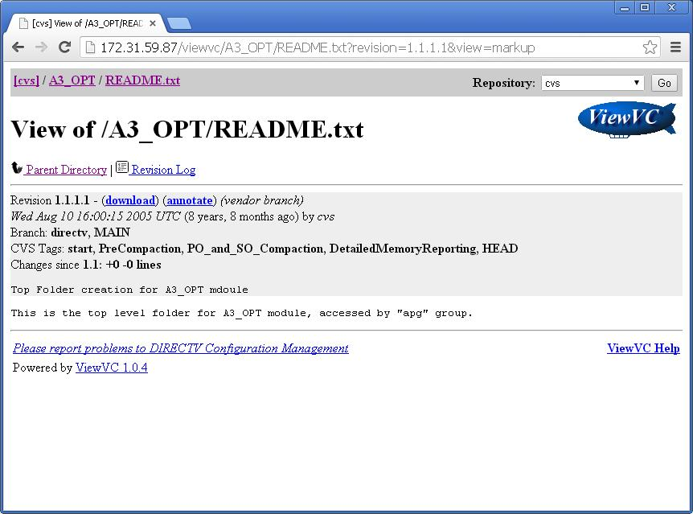
1.2. ViewVC Features (cont.)
File Contents View (Markup View) : Shows the contents of a file at a particular revision, with revision information at the top of the page. File revisions which are GIF, PNG, or JPEG images are displayed inline on the page. Other file types are displayed as marked up text. The markup may be limited to turning URLs and email addresses into links, or configured to show colorized source code.
File Download (Checkout View) : Retrieves the unaltered contents of a file revision. Browsers may try to display the file, or just save it to disk.
Confidential

Slide 7
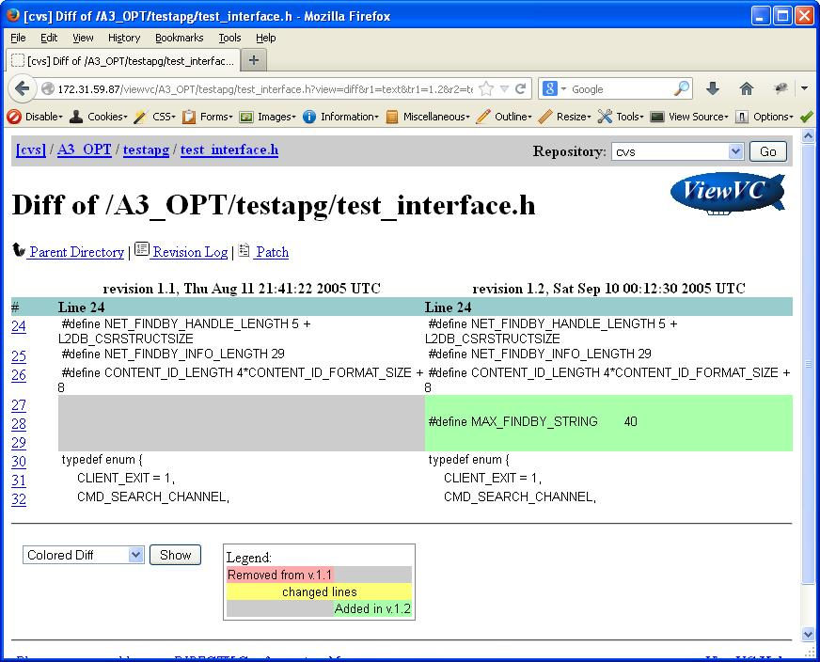
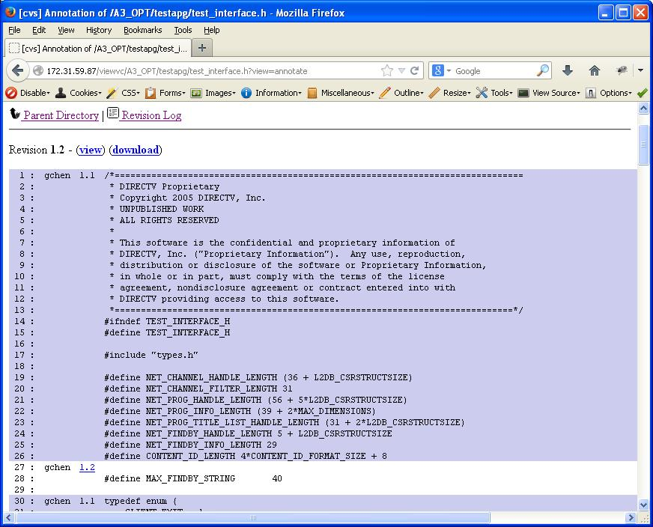
1.2. ViewVC Features (cont.)
File Annotate View : Shows the contents of a file revision and breaks it down line by line, showing the revision number where each one was last modified, along with links and other information. This view is disabled in some ViewVC configurations
File Diff View : Shows the changes made between two revisions of a file
Confidential

Slide 8
1.2. ViewVC Features (cont.)
Directory Tarball View : Retrieves a gzipped tar archive containing the contents of a directory. This view is disabled in the default ViewVC configuration.
Directory Query View : Shows information about changes made to all subdirectories and files under a parent directory, sorted and filtered by criteria you specify. This view is disabled in the default ViewVC configuration.
Revision View : Shows information about a revision including log message, author, and a list of changed paths. For Subversion repositories only.
Graph View : Shows a graphical representation of a file's revisions and branches complete with tag and author names and links to markup and diff pages. For CVS repositories only, and disabled in the default configuration.
Confidential

Slide 9
1.3. What are “HEAD” and “MAIN”?
HEAD and MAIN are built-in tags that don't show up in the "log" or "status" listings. They are interpreted directly by CVS.
"HEAD" refers to the latest revision on the current branch in the Repository. The current branch is either the main line of development, or a branch in development created by placing a branch tag on a set of files and checking out that branch.
“MAIN" refers to the revision on the current branch you last checked out, updated, or committed. If you have not modified your working file, “MAIN" is the committed revision matching it.
Most of the time MAIN and HEAD refer to the same revision. They can become different in two ways:
  Someone else changed HEAD by committing a new revision of your file to the Repository. You can pull MAIN up to equal HEAD by executing "update".
  You moved MAIN backward by executing "checkout" or "update“ to a special revision/tag or date. CVS records a sticky tag and moves your files to the specified earlier revision. You can clear the sticky tag and pull MAIN up to equal HEAD again by executing "update -A".
Confidential

Slide 10
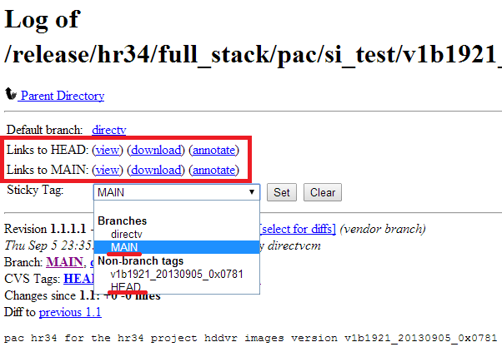
1.3. What are “HEAD” and “MAIN”? (cont.)
Confidential

Slide 11
2. DirecTV ViewVC System
Request New Account.
Account Permission.
Directory Structure.

Slide 12
2.1. Request New Account.
To request a CVS account, you are required to provide the encrypted password string. Please follow the procedures below to create the encrypted password string:
  Download the file encrypt.zip and uncompress it to a folder, i.e C:\encrypt
  Direct link: http://172.31.59.94/wiki/download/attachments/20415391/encrypt.zip?version=1&modificationDate=1302046728610&api=v2
  Open a MS-DOS session.
  cd to the directory which has encrypt.exe (i.e cd c:\encrypt).
  Execute the encrypt utility to generate the encrypt password string (i.e C\encrypt\encrypt <your password>)
  It generates a string. Note the encrypted string.
Please submit a JIRA task request to CM with below info:
  Name.
  Email.
  Role (tester / developer)
  The manager who the user will work for.
  The special access to secure sources: dms, fdm, dtcp, cdidrivers, moca_manager, xmp2
  The encrypted password (generated in above).
For CVS password reset, please fill only info:
  Name.
  Email.
  The encrypted password string.
Confidential

Slide 13
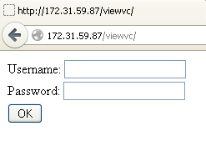
2.2. Account Permission
In DirecTV ViewVC system, we have 2 account types:
  Tester
  Developer
DirecTV ViewVC page: http://172.31.59.87/viewvc/
You are requested to login before using the system.
Which folders that your account have not permission to access, revision column displays text: “error: path is not accessible”.
Confidential

Slide 14
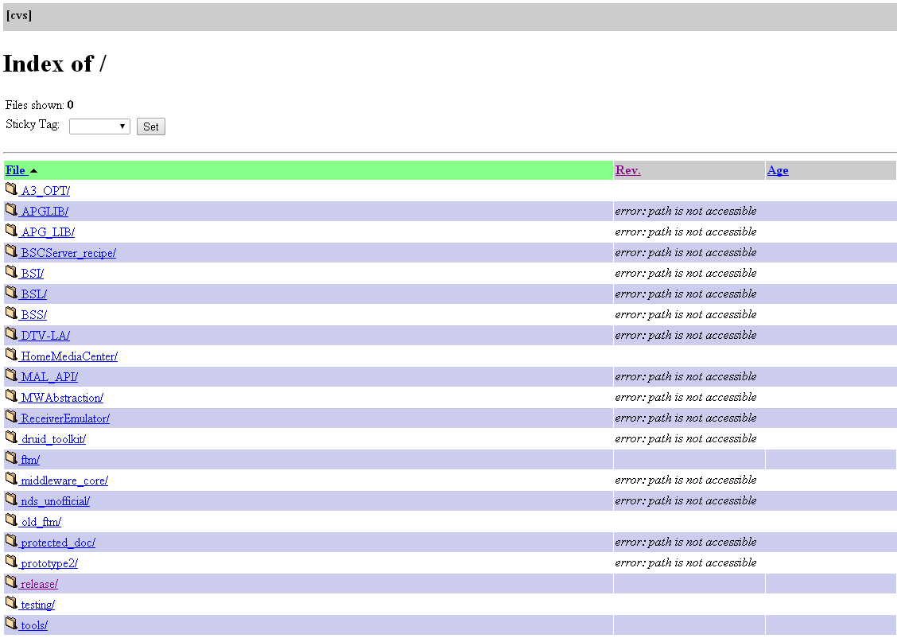
2.3. Directory Structure
Confidential

Slide 15
3. ViewVC for Tester
How to download a build?
How to identify Kernel & Boot command?
How to download plugins?

Slide 16
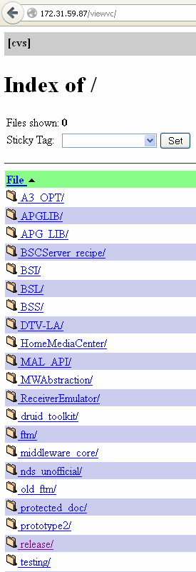
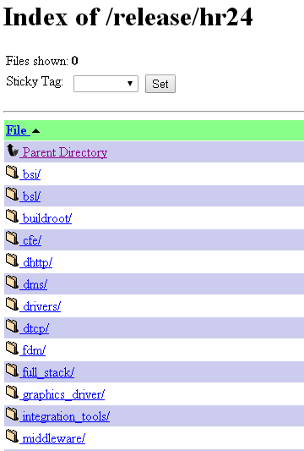
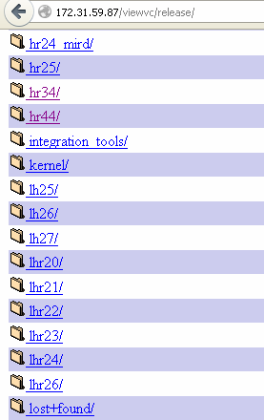
3.1. How to download a build?
  Login to system, then open “release” link:
  Select platform name (ex: hr24)
  Select full_stack
Confidential

Slide 17
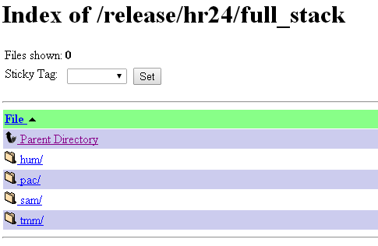
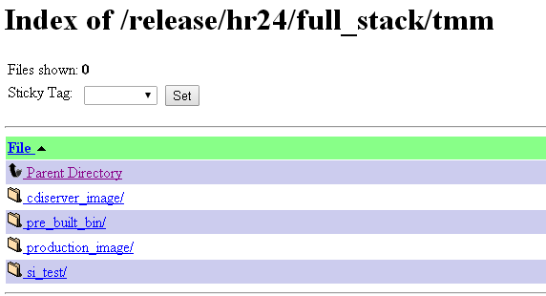
3.1. How to download a build? (cont.)
  Select platform manufacture (ex: tmm)
  Select build type folder. There are 2 types of build:
    Production build: the build released to customer. On this build type, console & ssh access are restricted, firewall is enabled. Build files are located under “production_image” link.
    Test build: the engineering build, often referred as SI (System Integration) image. On this type, console and ssh access are allowed. Build files are located under “si_test” link.
Confidential

Slide 18
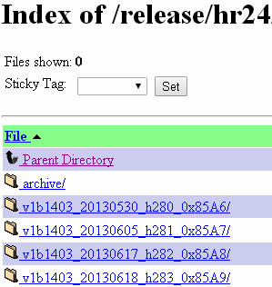
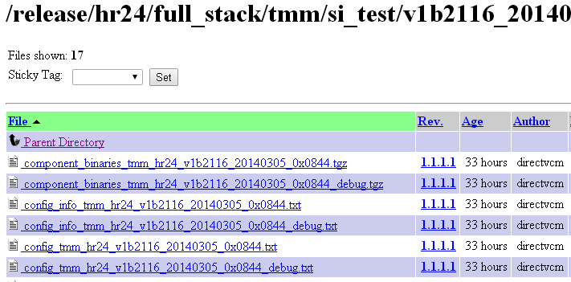
3.1. How to download a build? (cont.)
  Select a build version folder (ex: v1b2116_20140305_0x0844), the list of all file related to build version is displayed (log file, build info, image file, ..)
  We have 4 Image format types:
    NFS Image (.tgz)
      Root filesystem residing on a remote machine
      Requires NFS (Network File System) service and exporting of disk partitions
      Easiest to update, slowest performance
    Squashfs image (.squashfs)
      LZMA compressed flash root filesystem
      Requires flash programming capability
    Initrd image (.initrd)
      RAM disk root filesystem
      Requires initrd (Initial RAM disk) capability
    Bitstream image (.btz)
      Requires BSL and bitstream player to load this image
Confidential

Slide 19
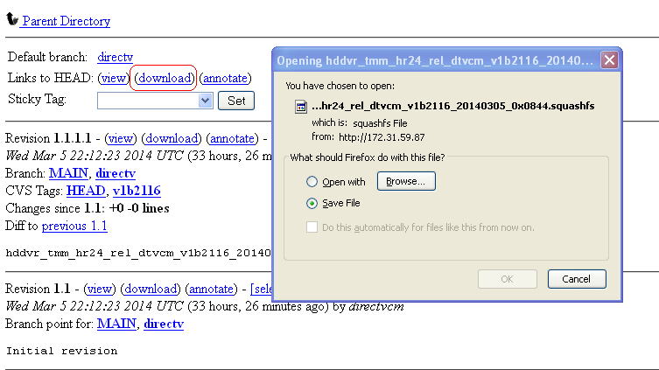
3.1. How to download a build? (cont.)
  Click on a build image file to open file download page, select the “download” link to start downloading.
  Save the build to correct target folder:
    .squashfs & .btz: save to /data/tftpboot/
    .tgz: create new folder in /data/nfs/ then save the file into.
Confidential

Slide 20
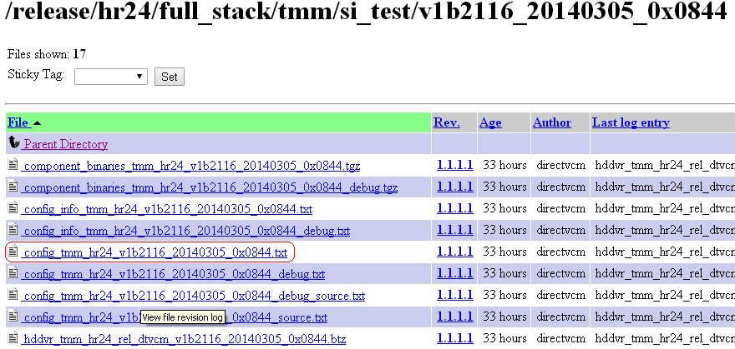
3.2. How to identify Kernel & Boot command
On each build version folder, checkout the config file to find the kernel & boot command info. (File name with format: “config_[platform]_[build].txt”)
Click “View” link to view the file info.
Confidential

Slide 21
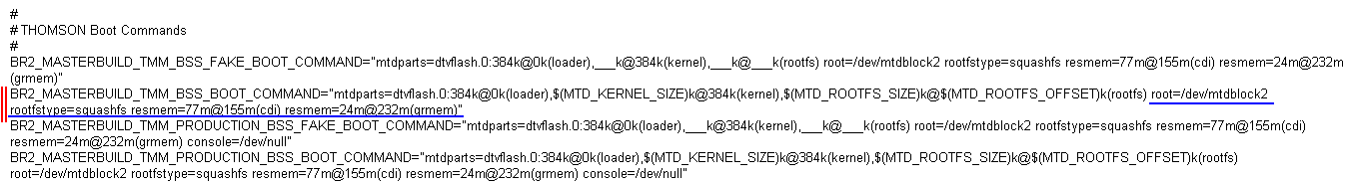
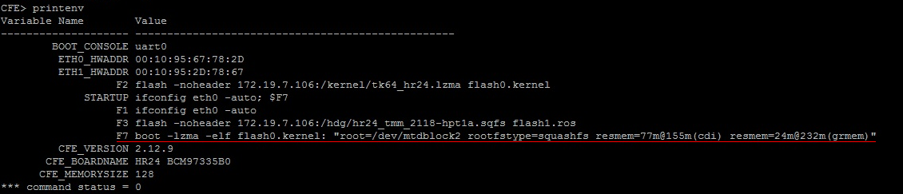

3.2. How to identify Kernel & Boot command (cont.)
Boot Command info:
  In this example (hr24-tmm), the boot command will be assigned to F7 key as below.
  Refer to this link for other platforms setting: http://172.31.59.94/wiki/display/TEST/HDGraphics+-+Flash+Boot+Commands
Kernel Info (usually, it’s located at the end of file). Note the kernel version.
Confidential

Slide 22
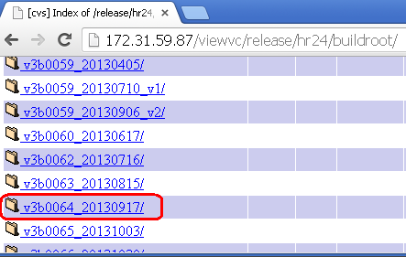
3.2. How to identify Kernel & Boot command (cont.)
Download Kernel:
  Go back to platform name folder then select “buildroot” folder (the same level with “full_stack” folder).
  Especially, with hr24 & h24 platform, we have 2 subfolders: “arm” and “mips”.
    Uboot Loader boxes (hr24-hum & h24-pac): select “arm” folder
    Others (ex: hr24-tmm, h24-sam, ..): select “mips” folder
Confidential

Slide 23
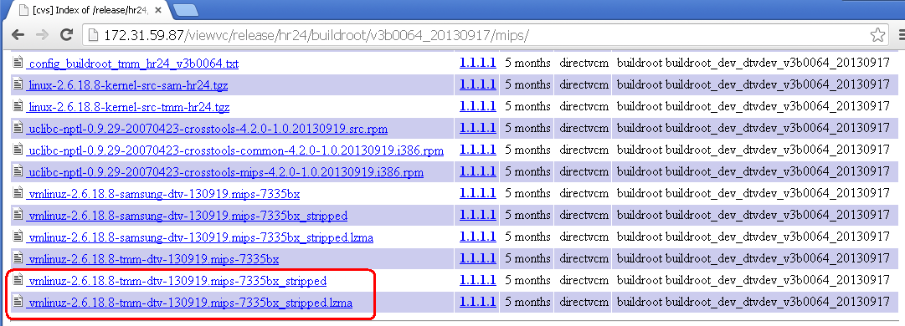
3.2. How to identify Kernel & Boot command (cont.)
  There are 2 kernel file match with your platform (_stripped & _stripped.lzma). Download the file corresponding with the boot command parameter you have set for the installation.
  The kernel file should be saved to /data/tftpboot/kernel/ folder.
Confidential

Slide 24
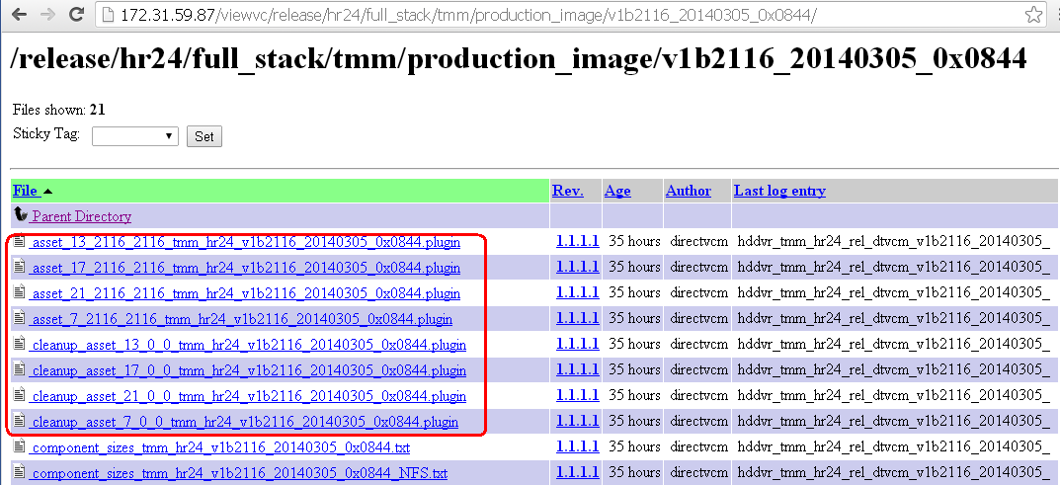
3.3. How to download plugins?
Plug-ins of a build are stored under "production_image" folder of that build (the same level with “si_test” folder).
There are several plug-in files. Click on each plug-in to access checkout view page then download it.
Create new folder in /data/tftpboot/plugins/ with the name similar to build version name, then save all plugins file of build into that folder.
Confidential

